Slide 1

FIRE SENSOR AND EXTINGUISHER
Made by- Shaili Sahu
Shivansh S.
Sharanya G.

Slide 2

AIM-
TO DETECT FIRE AND TO GIVE EMERGENCY ALARM
OBJECTIVE-
A flame-sensor is one kind of detector which is mainly designed for detecting as well as responding to the occurrence of a fire or flame. The flame detection response can depend on its fitting. It includes an alarm system, a natural gas line, propane & a fire suppression system. This sensor is used in industrial boilers. The main function of this is to give authentication whether the boiler is properly working or not. The response of these sensors is faster as well as more accurate compare with a heat/smoke detector because of its mechanism while detecting the flame.
In our project we rely on temperature sensor, gas sensor and light sensor to sense the fire, we also have used a motor as a pump to extinguish the fire.

Slide 3





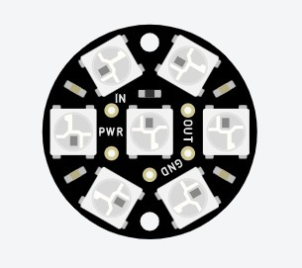

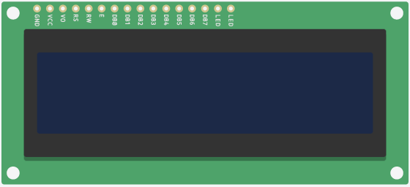
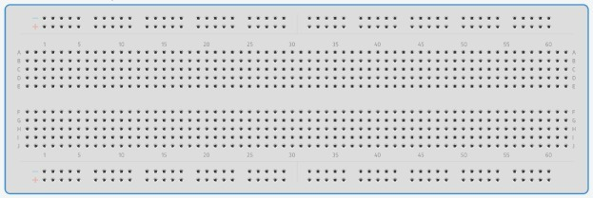


COMPONENTE USED-
ARDUINO UNO R3
BREADBOARD
RESISTORS
PIEZO
LCD (liquid crystal display)
SMOKE SENSOR
TEMERATURE SENSOR
PHOTOTRANSISTOR (Light sensor)
POTENTIOMETER
NEO-PIXEL JEWEL
MOTOR (pump)
CONNECTING WIRES

Slide 4
COMPONENTE AND ITS USES-
Arduino refers to an open-source electronics platform or board and the software used to program it.
ARDUINO
A liquid-crystal display is a flat-panel display or other electronically modulated optical device that uses the light-modulating properties of liquid crystals combined with polarizers
LCD
A plastic board used to make quick electrical connections between components
BREAD BOARD
The phototransistor is a semiconductor device that is able to sense light levels and alter the current flowing between emitter and collector according to the level of light it receives.
PHOTOTRANSISTOR (Light sensor)

Slide 5
The main function of motor is to change the energy from electrical to mechanical. A pump operates with a motor
Gas sensors (also known as gas detectors) are electronic devices that detect and identify different types of gasses. They are commonly used to detect toxic or explosive gasses and measure gas concentration.
MOTOR
GAS SENSOR
Device that has electrical resistance and that is used in an electric circuit for protection, operation, or current control.
A device used to measure temperature. This can be air temperature, liquid temperature or the temperature of solid matter.
RESISTOR
TEMPERATURE SENSOR
Instrument for measuring an electromotive force by balancing it against the potential difference produced by passing a known current through a known variable resistance.
The Neopixel are RGB leds individually addressable and chained into bands and rings.
POTENTIOMETER
NEO-PIXEL JEWEL

Slide 6
CODE-
// C++code
//
#include <LiquidCrystal.h>
#define D4 7
#define D5 6
#define D6 5
#define D7 4
#define E 8
#define RS 9
#include <Adafruit_NeoPixel.h>
#define PIN 2
#define N_LEDS 12
LiquidCrystal LCD(9,8,7,6,5,4);
int piezo =3;
int pump = 10;
int temp = 0;
int light = 0;
Adafruit_NeoPixel strip = Adafruit_NeoPixel(N_LEDS, PIN, NEO_GRB + NEO_KHZ800);
void setup()
{
Serial.begin(9600);
pinMode(A0, INPUT); // temp sensor
pinMode(A1,INPUT);// gas sensor
pinMode(A2,INPUT);// phototransistor
pinMode(piezo,OUTPUT);
pinMode(pump,OUTPUT);
LCD.begin(16,2);
strip.begin();
}

Slide 7
void loop()
{
int temp=analogRead(A0);
Serial.print("The Temperature is : ");
Serial.println(temp);
int light= analogRead(A2);
Serial.print("The value of Phototransistor :");
Serial.println(light);
int a= analogRead(A1);
int b= map(a,0,1023,0,255);
Serial.print("The gas intensity is : ");
Serial.println(b);
delay(2000);
if ((b>70 && light>5 ) || (temp>80 && light>5) || (b>70 && temp>80))
{
digitalWrite(piezo,HIGH);
digitalWrite(pump,HIGH);
LCD.clear();
LCD.setCursor(0,0);
LCD.print("ALERT");
delay(1000);
LCD.clear();
LCD.setCursor(0,1);
LCD.print("EVACUATE");
delay(1000);
chase(strip.Color(255, 0, 0)); //Red
delay(100);
}

Slide 8
else
{
digitalWrite(piezo,LOW);
digitalWrite(pump,LOW);
LCD.clear();
LCD.setCursor(0,0);
LCD.print("SAFE");
delay(1000);
LCD.clear();
LCD.setCursor(0,1);
LCD.print("ALL CLEAR");
delay(1000);
chase(strip.Color(0, 255, 0)); //green
delay(100);
}
}
static void
chase(uint32_t c)//Loop of the NeoPixel Strip
{
for(uint16_t i=0; i<strip.numPixels()+12; i++)
{
strip.setPixelColor(i , c);
strip.setPixelColor(i-8, 0);
strip.show();
delay(10);
}
}

Slide 9
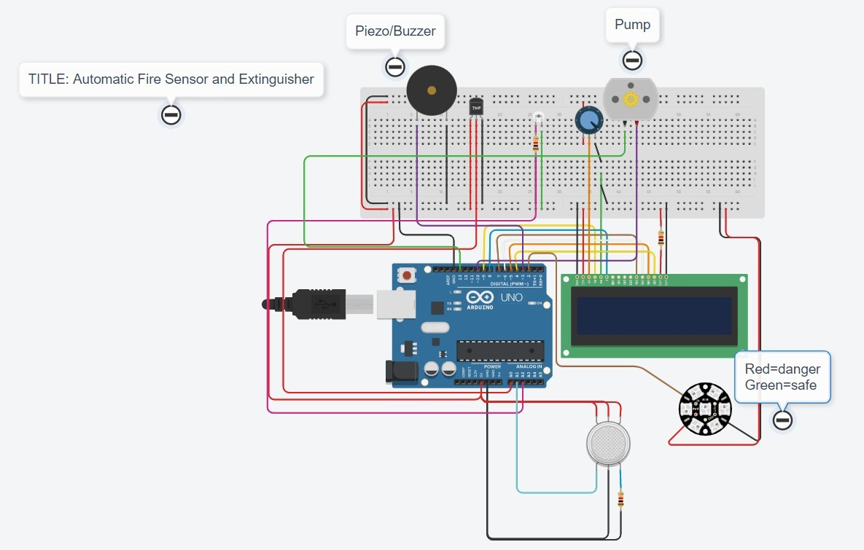
SCHEMATIC DIAGRAM

Slide 10
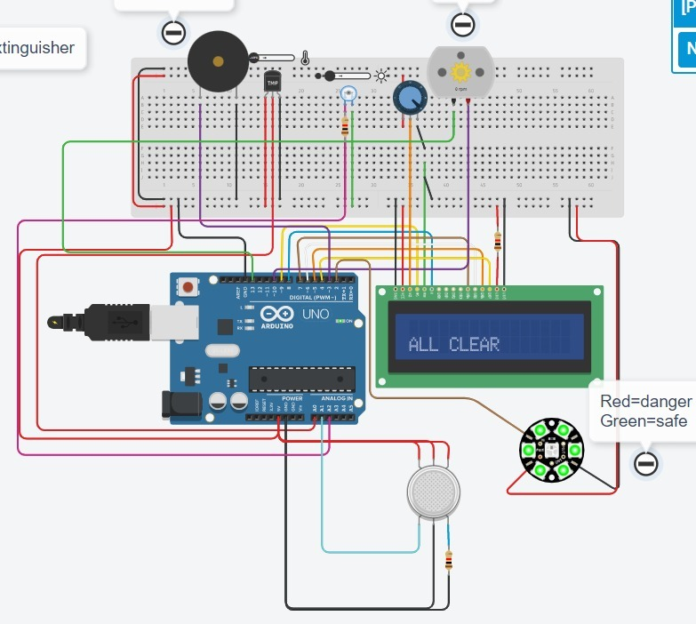
SIMULATION RESULTS
SAFE CONDITION

Slide 11
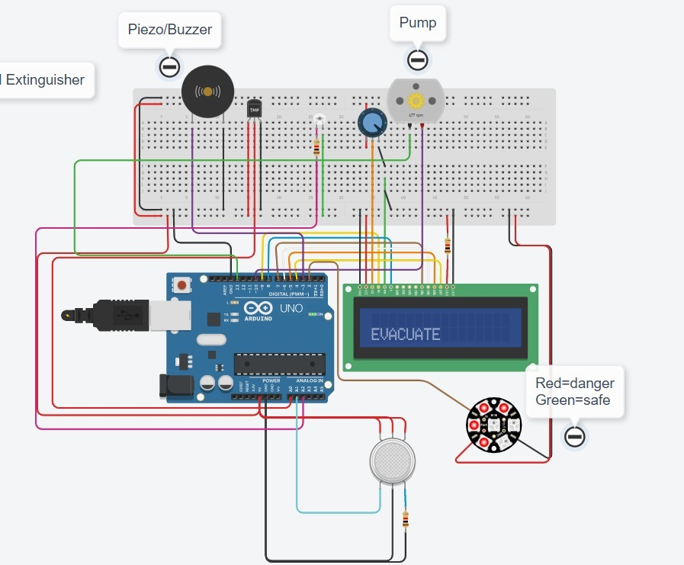

CONDITION 1: (intensity>70 and light>5)

Slide 12

CONDITION 2: (temp>80 && light>5)

Slide 13
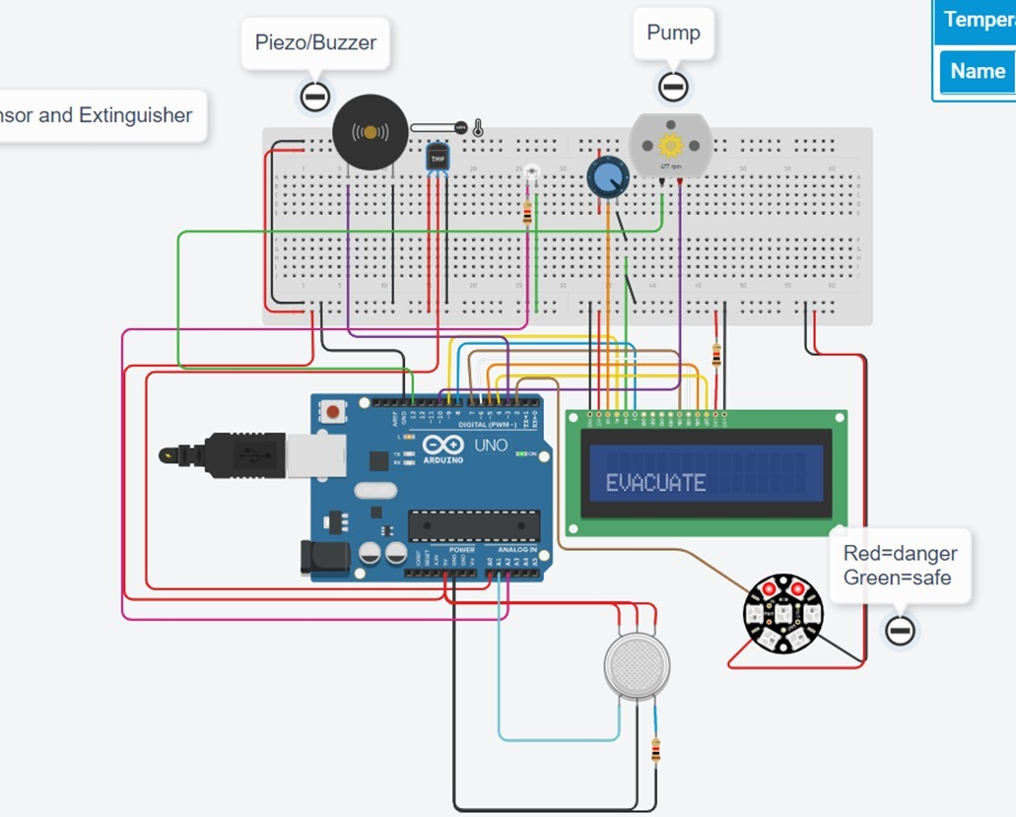

CONDITION 3: (b>70 && temp>80

Slide 14
Explanation:
Fire Sensor and Extinguisher
A Fire Sensor and Extinguisher is a critical safety element in environments where there is a hazard due to fire. It not only senses the danger but it also provides protection by extinguishing the fire.
Our fire sensor sense fire on the basis of 3 conditions-
•Temperature increases above 80 units
•Intensity of light reaches above 5 units
•Intensity of smoke reaches above 70 units
The alarm in the Flame sensor rings when either of the above conditions is met. Simultaneously, the pump gets activated.
Also, the LCD that showed safe before the conditions were met now shows alert and evacuate followed by neo pixel jewel changing colours from Green to Red.

Slide 15
Link to our project:
https://www.tinkercad.com/things/eC7Pw3g0wMn-iot-proj-adv-final-final-
Reference:
https://www.tinkercad.com/things/7qNLnFgH23h-fire-detection-mechanism
https://www.tinkercad.com/things/bazel5GB75k-temp-and-photo-resistor

Slide 16

THANK YOU

